Slide 1

Stata: Data Management
John McDonnell
Sarah Worley
Wei Liu

Slide 2
Course Materials
https://github.com/JACKMCDONNELL/Stata-fellows

Slide 3
Importing from RedCap

Slide 4
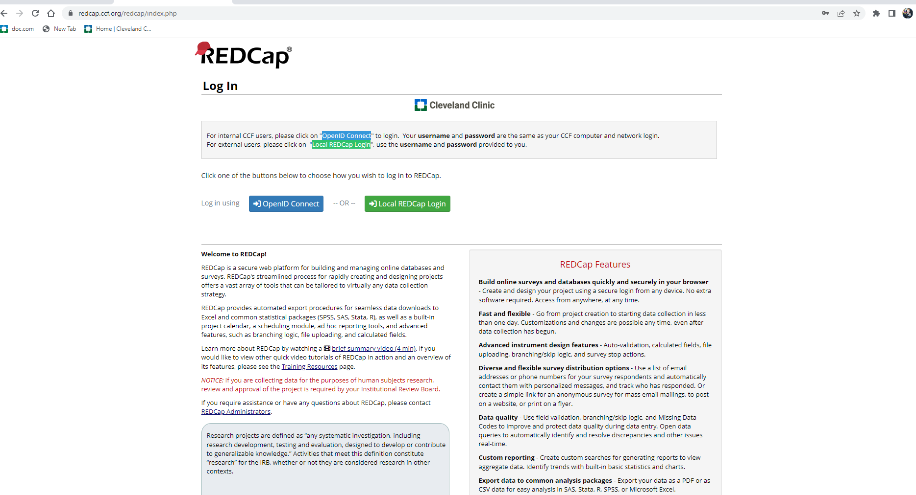

Slide 5
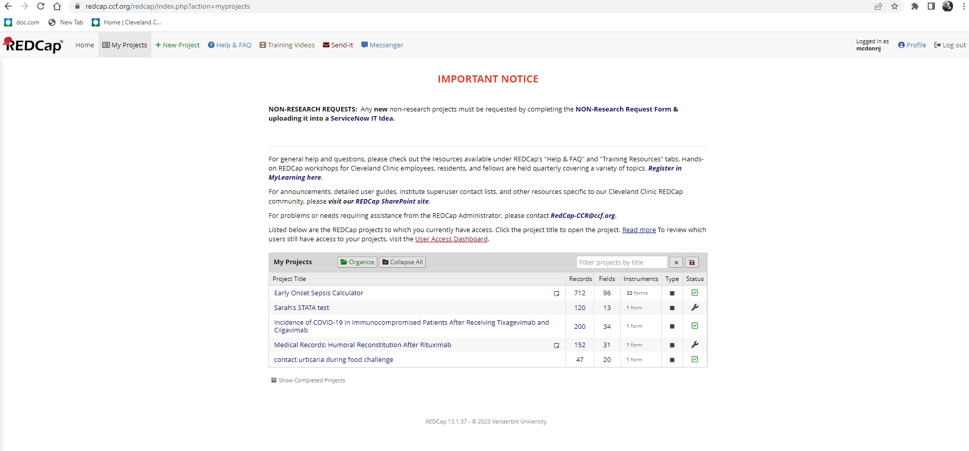

Slide 6
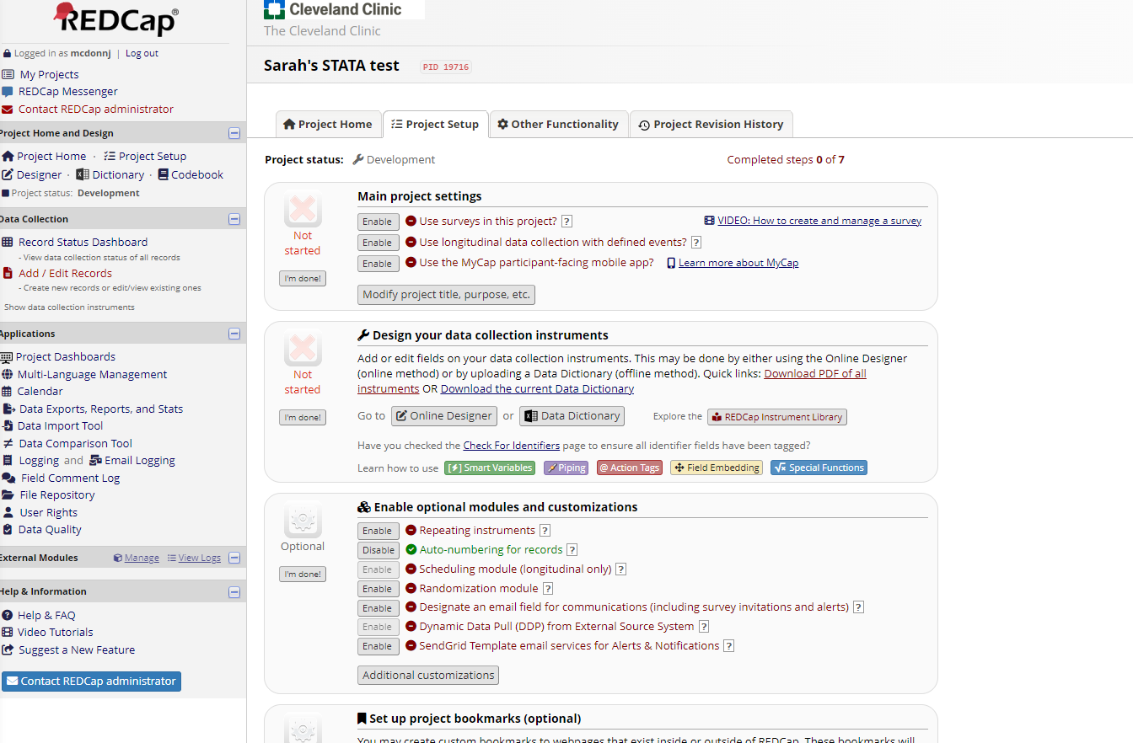

Slide 7
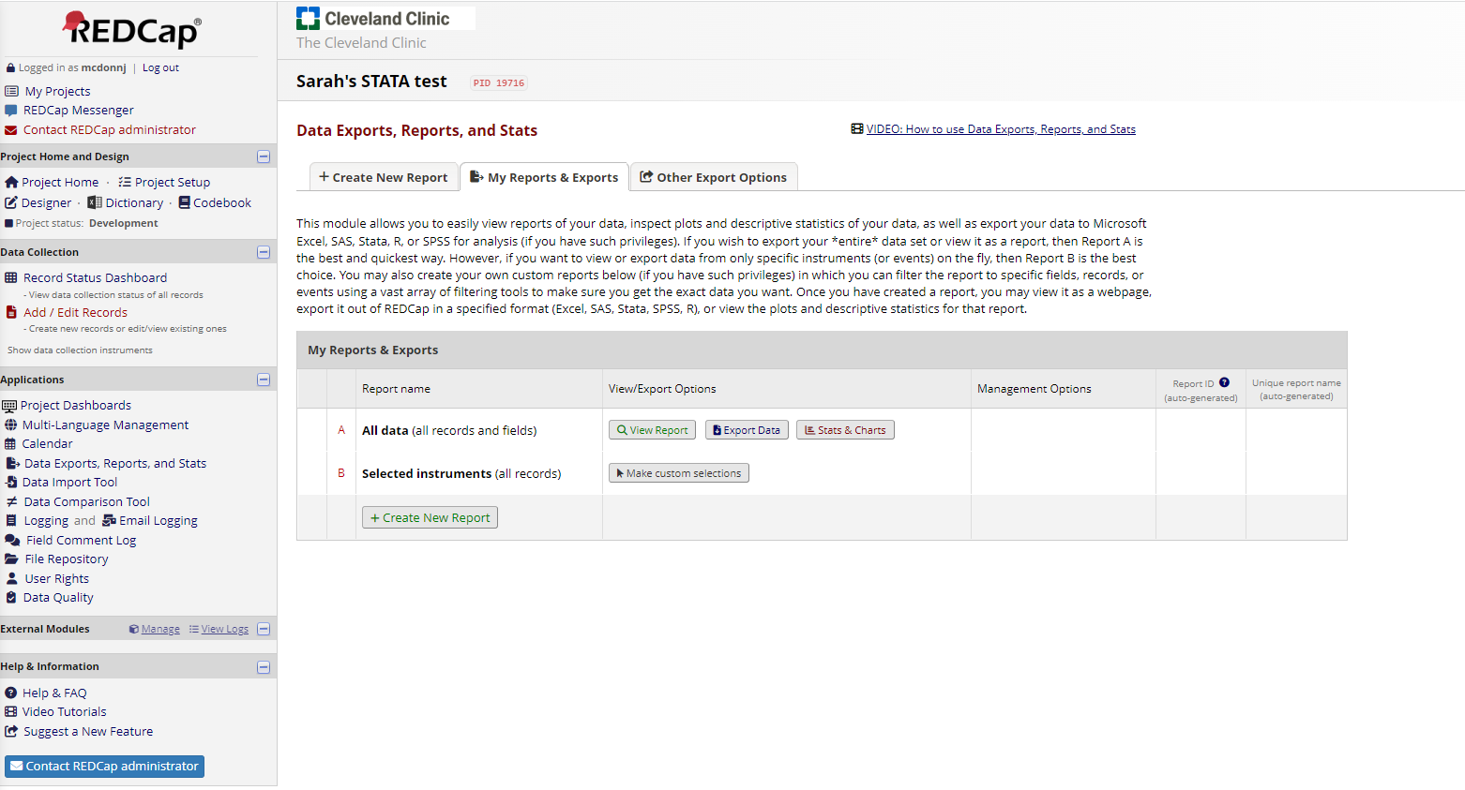

Slide 8
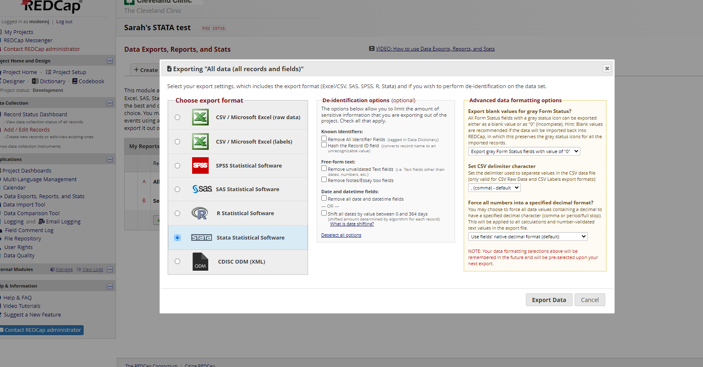

Slide 9
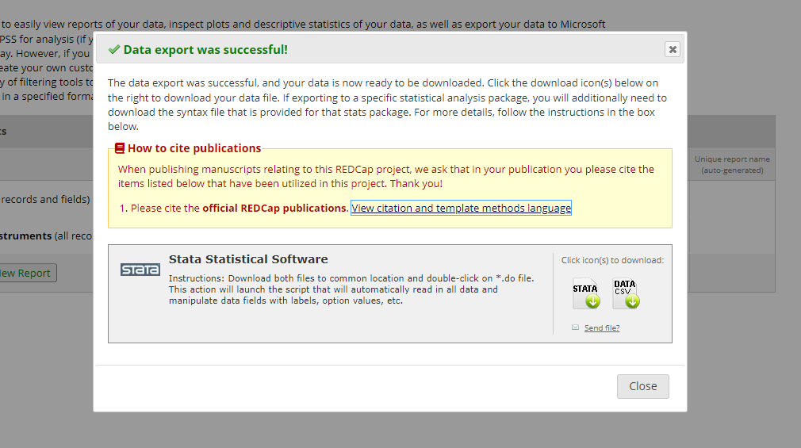

Slide 10
Importing from Excel

Slide 11
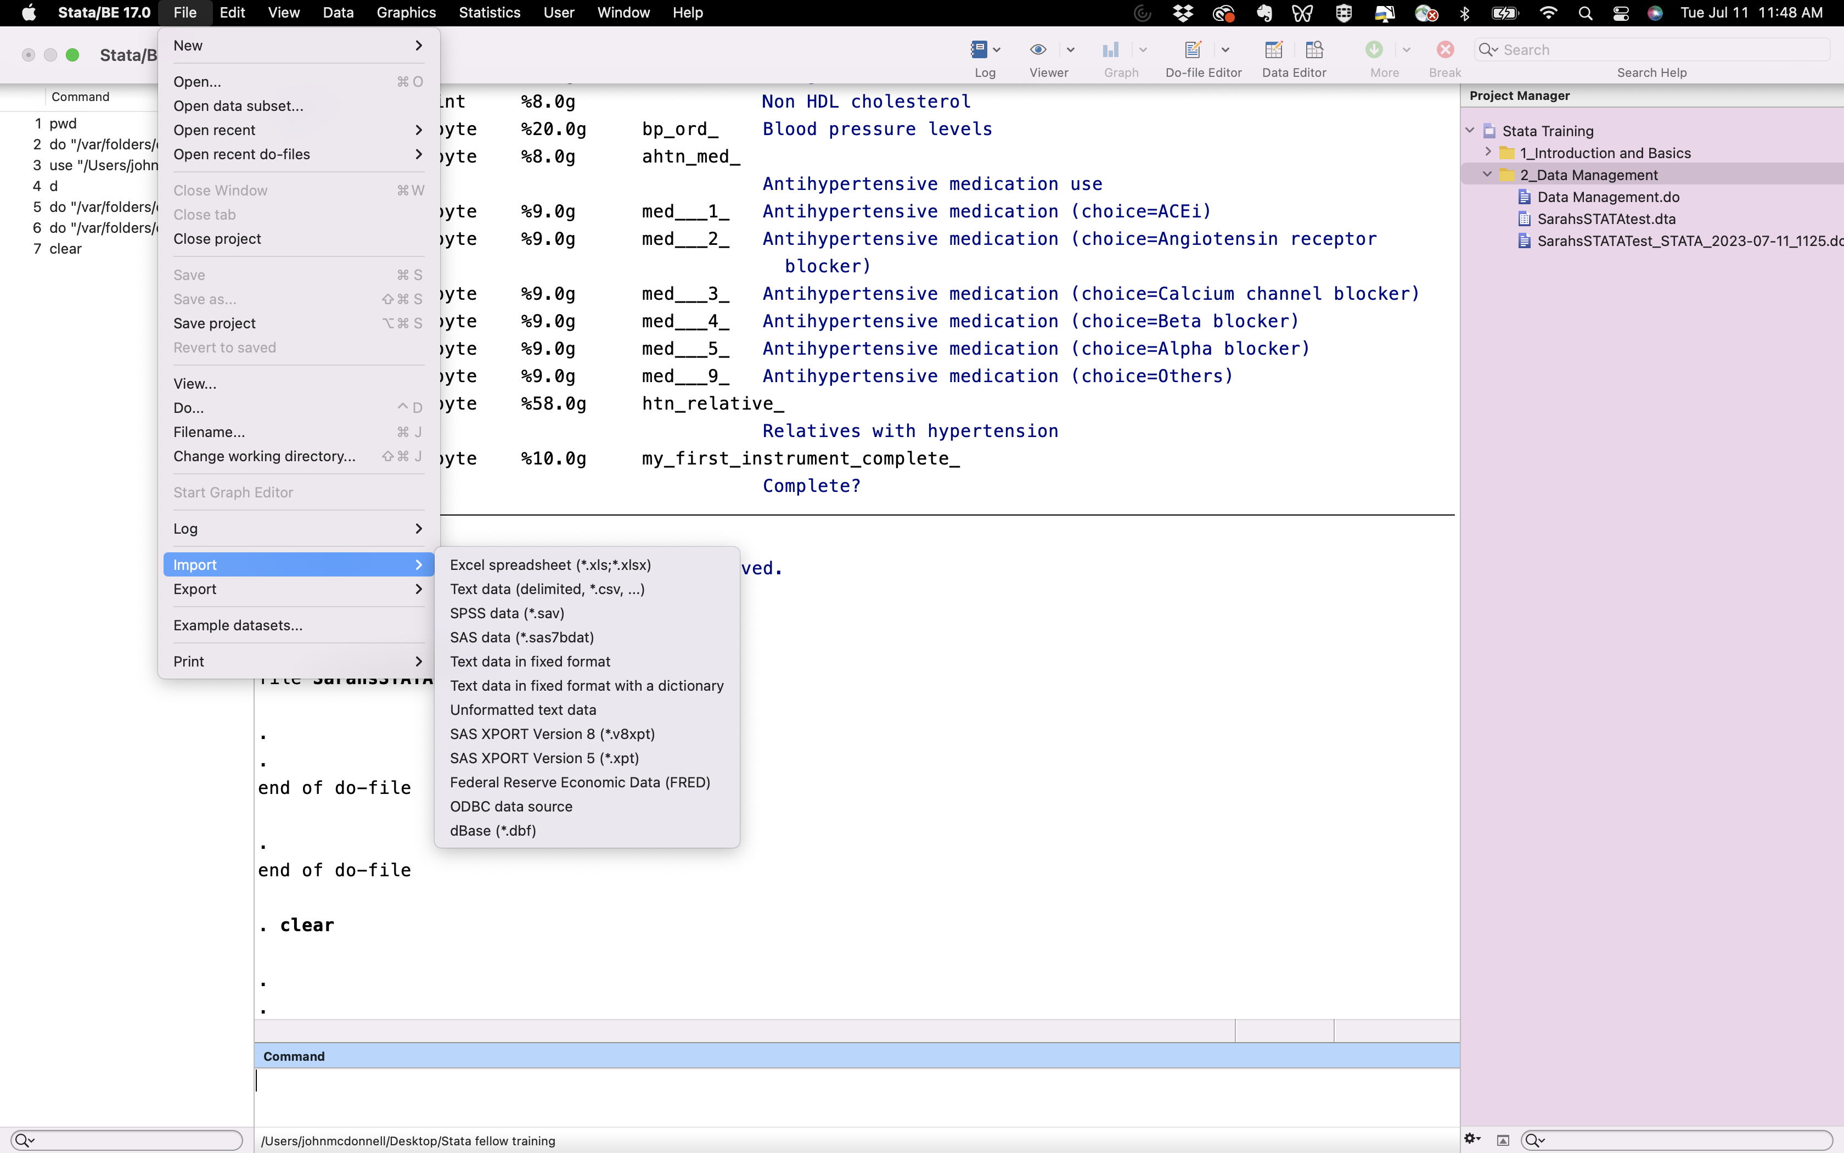

Slide 12
